Slide 1
Phase2: Database Team project
Team 8
2013105011 김도한
박준헌
이종준

Slide 2
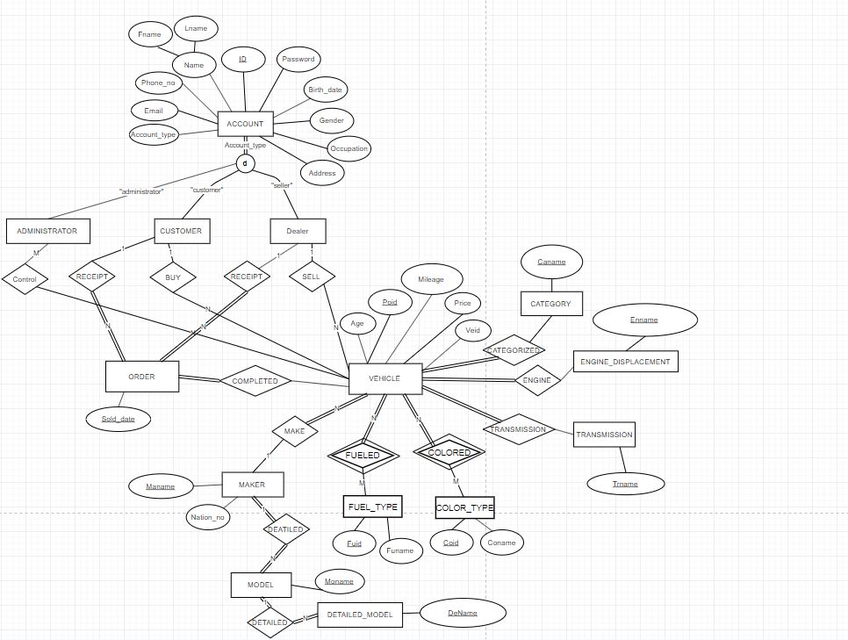

Slide 3
Account
ID | Password | Lname | Fname | Phone_no | Birthdate | Gender | Email | Address | Account_type
Occupation
Customer
Cuid
Dealer
Deid
Administrator
Adid
Control
Adid | Poid
Vehicle
Age | Veid | Mileage | Enname | Trname | Caname | Poid | Deid | Price | Maname | Moname
Color_Type
Coname | Coid
Orders
Sold_date | Cuid | Poid
Maker
Maname | Nation_no
Engine_Displacement
Enname
Model
Moname | Maname
Transmission
Trname
Dename | Moname
Detailed_Model
Fuel_Type
Funame | Fuid
Colored
Poid | Coid
Category
Caname
Fueled
Poid | Fuid

